Slide 1
E-COMMERCE PROJECT
This project is about sales of an USA based company.
The complete dataset has 22 columns and 99995 rows.
The fields or columns dataset has are follows:
Row id, Order ID, Year, Order Date, Ship Date, Ship Mode, Customer ID, Customer Name, Segment, Country, City, State, postal_ code, Region, Product-id, Category, Sub-category, Product Name, sales, Quantity, Discount and profit respectively
DATA SOURCE LINK - https://github.com/satg01/E-commerce/blob/main/E-commerce%20sales%20dataset.csv

Slide 2
QUESTION BASED ON DATASET
in which month Sales and profit were high in 2011
in which month Sales and profit were high in 2012
in which month Sales and profit were high in 2013
in which month Sales and profit were high in 2014
In which category company have higher profit?
In which category company have higher sale
What are the cities with higher no. of sales.
What are the states with Higher NUMBER OF SALES ?
No of quantities sold in 2011-2014 yearly
Sales in different region?
.
.

Slide 3
In which month sales and profit were high ON 2011?
Highest & lowest Sales and Profit in 2011’
Sales highest- $67350 ,Month December
Sales lowest – $13130 February
Profit highest $10227 ,Month September
Loss -$336 month July

Slide 4
In which month sales and profit were high On 2012?
Highest & lowest Sales and Profit in 2012
Sales highest- $66729 ,Month September
Sales lowest – $20998 February
Profit highest $10112 ,Month August
Lower Profit -$672 month July

Slide 5
In which month sales and profit were high on 2013?
Highest & lowest Sales and Profit in 2013
Sales highest- $74356 ,Month December
Sales lowest – $21998 January
Profit highest $12795 ,Month May
Lowest Profit -$2653 Month January

Slide 6
In which month sales and profit high in 2014?
Highest & lowest Sales and Profit in 2014
Sales highest- $84924 ,Month November
Sales lowest – $40366 July
Profit highest $14047 ,Month March
Lower Profit -$1515 Month May

Slide 7
Top 5 SeLling SUB-CATEGORIES
In term of Sub-Categories the highest selling was of phones, chairs and storage respectively

Slide 8
WHAT IS THE TOTAL ORDERS FROM 2011-2014
Orders get by company in Years :
2011 : 1993
2012 : 2102
2013 : 2580
2014 : 3318

Slide 9
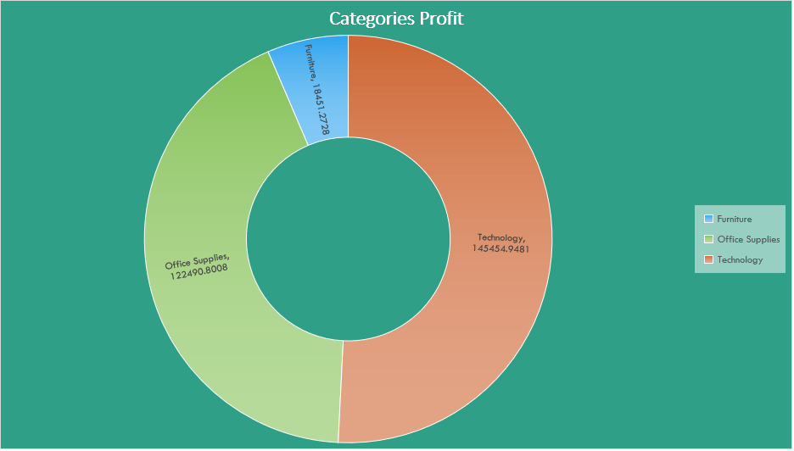
In which category company has higher profit?
As we can see company in category technology, company profited an see here higher profit earned by $145455.

Slide 10
In which category company have higher sale?
Company has made highest sale in technology ,$836154 which is 37% of total sale

Slide 11
What are the cities with higher no. of sales.

Slide 12
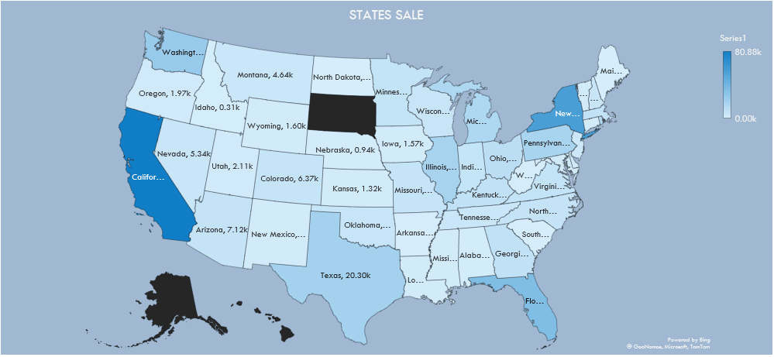
What are the states with Higher SALE name?
TOP 5 STATE WITH HIGHER NUMBER OF SALES ARE CALIFORNIA $457687, NEWYORK $310876 , TEXAS $170188 ,WASHINGTON $138641 AND PENNSYLVANIA $ 116512 RESPECTIVELY

Slide 13
WHAT’S THE No. of quantities WERE sold FROM 2011-2014 yearly?
THE NUMBER OF QUANTITIES WERE SOLD FROM 2011 # 7581,
#7479
#9810
#12503 RESPECTIVELY

Slide 14
WHAT IS THE SALE WERE MADE IN REGIONS?
AS WE CAN SEE HERE THE HIGHER SALE WERE MADE IN WEST REGION AND THAT IS $725457, EAST $678781 , CENTRAL $501239 AND SOUTH $391721 .

Slide 15
WHAT IS THE SALES AND PROFIT IN DIFFERENT SEGMENT?
CONSUMER- SALES : $1161401 , PROFIT : $114119
CORPORATE -SALE: $706146, PROFIT : $91979
HOME OFFICE - SALES : $429653 , PROFIT : $429653

Slide 16
PROFIT MARGIN
The company made higher profit margin in 2013 13.43% and lowest on 10.23% .

Slide 17
Conclusion
In the given dataset after creating various sales chart now its clear that The highest selling was of technology category , which is 37% of total sale .
in technology the most selling products is phone , while in furniture category highest selling products of chairs .
So the highest selling ordered was on 2014 and that is 3319 orders.
the highest selling were made on November 2014 , $84,924 and lowest on February 2011, $13130.
Company has made higher profit from technology category products.
The higher number of sales were made from consumer segment while home-office has made lowest sale
the company has made highest profit from consumer segment.
The company made higher profit margin in 2013 13.43% and lowest on 10.23% .
The higher sales States are California and Texas while the cities are New York and Los Angeles .
The higher number of the quantities were sold in 2014.
In Regions higher sales and profit made from west and east respectively

Slide 18
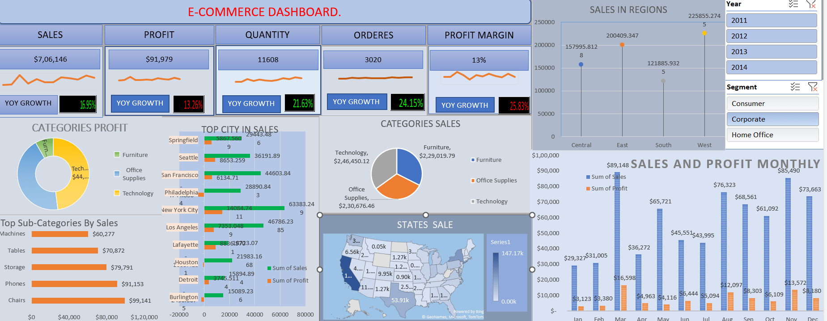
INTERACTIVE DASHBOARD

Slide 19
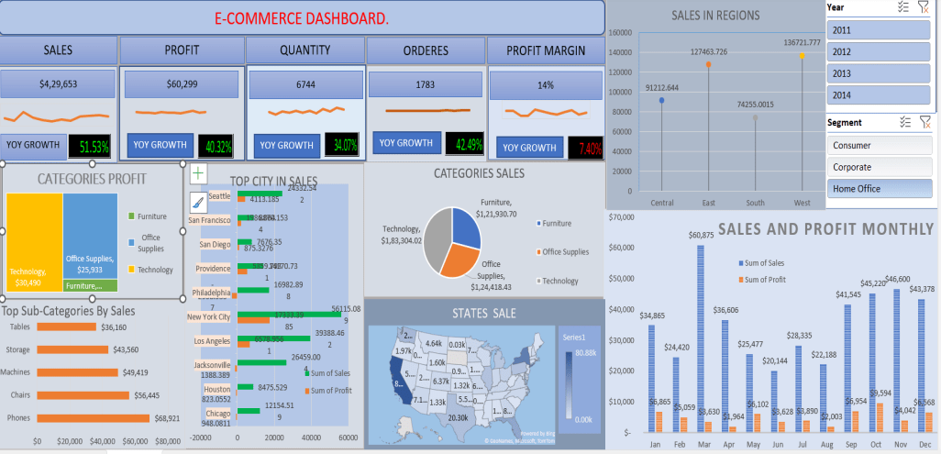
SCREENSHOT HOME OFFICE SEGMENT

